Slide 1
More Advanced Feature Engineering for BI: NLP & Beyond
Damian A. Tamburri, Ph.D.

Slide 2
Overview
Feature engineering overview
Common approaches to featurizing with text
Feature selection
Iterating and improving (and dealing with mistakes)

Slide 3
Goals of Feature Engineering
Convert ‘context’ -> input to learning algorithm.
Expose the structure of the concept to the learning algorithm.
Work well with the structure of the model the algorithm will create.
Balance number of features, complexity of concept, complexity of model, amount of data.

Slide 4
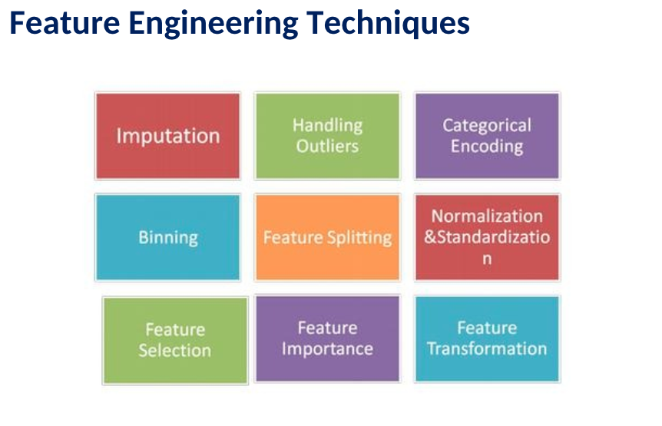
Notes:
Imputation ➔ “guessing“ missing values

Slide 5
We’ve Covered This Already!
Notes:
Imputation ➔ “guessing“ missing values

Slide 6
Notes:
Imputation ➔ “guessing“ missing values

Slide 7
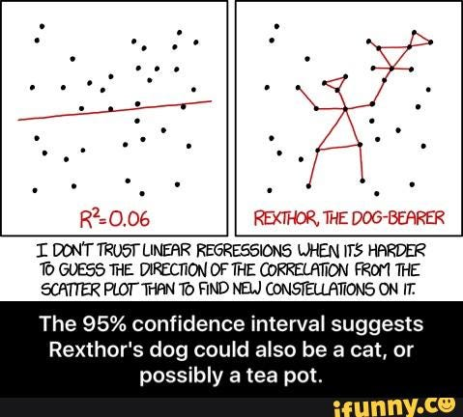
Feature Imputation

Slide 8
Notes:
Imputation ➔ “guessing“ missing values

Slide 9
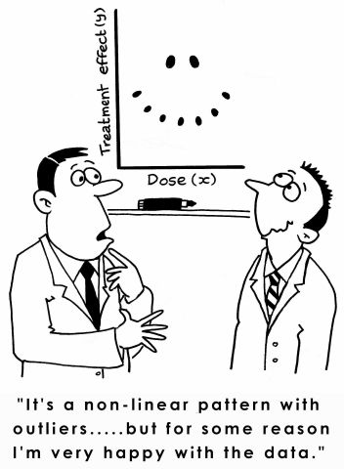
Feature Outliers

Slide 10
Notes:
Imputation ➔ “guessing“ missing values

Slide 11
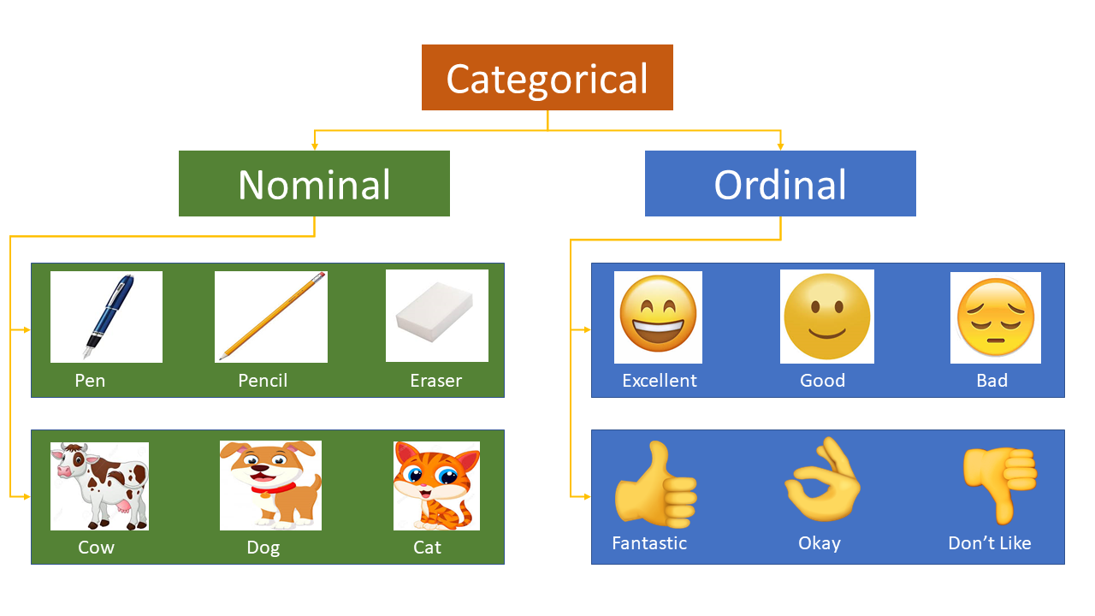
Categorical Encoding

Slide 12
Notes:
Imputation ➔ “guessing“ missing values

Slide 13
Feature transformation

Slide 14
Sample from SMS Spam
SMS Message (arbitrary text) -> 5 dimensional array of binary features
1 if message is longer than 40 chars, 0 otherwise
1 if message contains a digit, 0 otherwise
1 if message contains word ‘call’, 0 otherwise
1 if message contains word ‘to’, 0 otherwise
1 if message contains word ‘your’, 0 otherwise
“SIX chances to win CASH! From 100 to 20,000 pounds txt> CSH11 and send to 87575. Cost 150p/day, 6days, 16+ TsandCs apply Reply HL 4 info”
Long? | HasDigit? | ContainsWord(Call) | ContainsWord(to) | ContainsWord(your)

Slide 15
Basic Feature Types
Binary Features
ContainsWord(call)?
IsLongSMSMessage?
Contains(*#)?
ContainsPunctuation?
Categorical Features
FirstWordPOS ->
{ Verb, Noun, Other }
MessageLength ->
{ Short, Medium, Long, VeryLong }
TokenType ->
{ Number, URL, Word, Phone#, Unknown }
GrammarAnalysis ->
{ Fragment, SimpleSentence, ComplexSentence }
Numeric Features
CountOfWord(call)
MessageLength
FirstNumberInMessage
WritingGradeLevel

Slide 16
Converting Between Feature Types
Single threshold
Numeric Feature => Binary Feature
Length of text + [ 40 ] => { 0, 1 }
Numeric Feature => Categorical Feature
Length of text + [ 20, 40 ] => { short or medium or long }
Categorical Feature => Binary Features
{ short or medium or long } => [ 1, 0, 0] or [ 0, 1, 0] or [0, 0, 1]
Binary Feature => Numeric Feature
{ 0, 1 } => { 0, 1 }
Set of thresholds
One-hot encoding
…

Slide 17
Sources of Data for Features
System State
App in foreground?
Roaming?
Sensor readings
Content Analysis
Stuff we’ve been talking about
Stuff we’re going to talk about next
User Information
Industry
Demographics
Interaction History
User’s ‘report as junk’ rate
# previous interactions with sender
# messages sent/received
Metadata
Properties of phone #s referenced
Properties of the sender
Run other models on the content
Grammar
Language
…

Slide 18
Zoom-in: Feature Engineering for Text
Tokenizing
Bag of Words
N-grams
TF-IDF
Embeddings
NLP

Slide 19
Tokenizing
Breaking text into words
“Nah, I don't think he goes to usf” ->
[ ‘Nah,’ ‘I’, ‘don't’, ‘think’, ‘he’, ‘goes’, ‘to’, ‘usf’ ]
Dealing with punctuation
“Nah,” ->
[ ‘Nah,’ ] or [ ‘Nah’, ‘,’ ] or [ ‘Nah’ ]
“don't” ->
[ ‘don't’ ] or [ ‘don’, ‘'’, ‘t’ ] or [ ‘don’, ‘t’ ] or [ ‘do’, ‘n't’ ]
Normalizing
“Nah,” ->
[ ‘Nah,’ ] or [ ‘nah,’ ]
“1452” ->
[ ‘1452’ ] or [ <number> ]
Some tips for deciding
If you have lots of data / optimization…
Keep as much information as possible
Let the learning algorithm figure out what is important and what isn’t
If you don’t have much data / optimization...
Reduce the number of features you maintain
Normalize away irrelevant things
Focus on things relevant to the concept…
Explore data / use your intuition
Overfitting / underfitting ← much more later

Slide 20
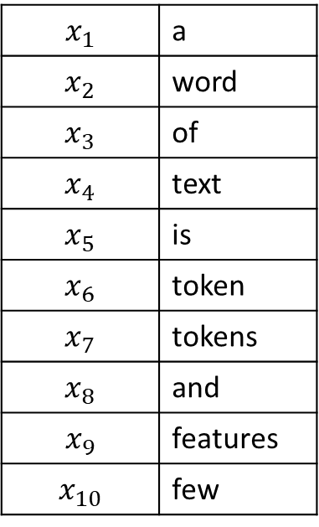
Bag of Words
One feature per unique token
Bag of words
word
of
$$x_{1}$$ | a
$$x_{2}$$ | word
$$x_{3}$$ | of
$$x_{4}$$ | text
$$x_{5}$$ | is
$$x_{6}$$ | token
$$x_{7}$$ | tokens
$$x_{8}$$ | and
$$x_{9}$$ | features
$$x_{10}$$ | few
text
a
m1:
m2:
m3:
m4:
A word of text.
A word is a token.
Tokens and features.
Few features of text.
word
is
a
a
token
features
tokens
and
few
features
of
text
Training data
Tokens
Features

Slide 21
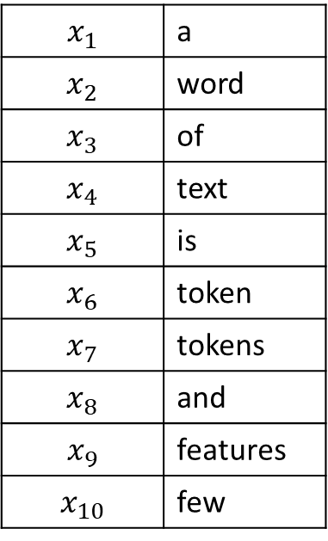
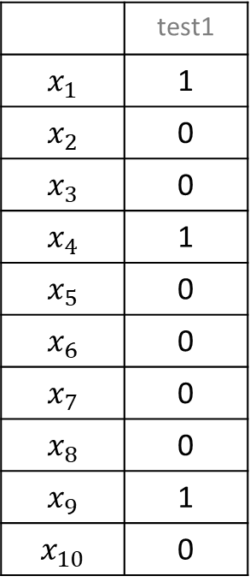
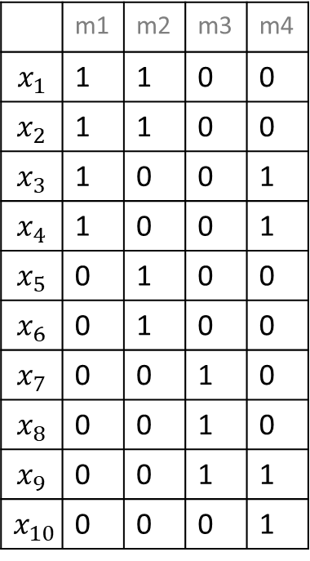
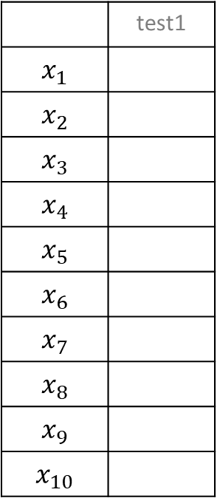
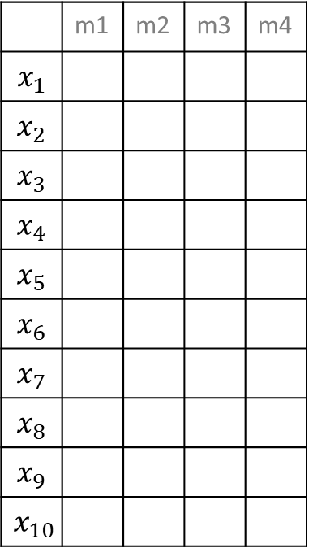
Bag of Words: Example
test1: Some features for a text example.
 | m1 | m2 | m3 | m4
$$x_{1}$$
$$x_{2}$$
$$x_{3}$$
$$x_{4}$$
$$x_{5}$$
$$x_{6}$$
$$x_{7}$$
$$x_{8}$$
$$x_{9}$$
$$x_{10}$$
 | test1
$$x_{1}$$
$$x_{2}$$
$$x_{3}$$
$$x_{4}$$
$$x_{5}$$
$$x_{6}$$
$$x_{7}$$
$$x_{8}$$
$$x_{9}$$
$$x_{10}$$
 | m1 | m2 | m3 | m4
$$x_{1}$$ | 1 | 1 | 0 | 0
$$x_{2}$$ | 1 | 1 | 0 | 0
$$x_{3}$$ | 1 | 0 | 0 | 1
$$x_{4}$$ | 1 | 0 | 0 | 1
$$x_{5}$$ | 0 | 1 | 0 | 0
$$x_{6}$$ | 0 | 1 | 0 | 0
$$x_{7}$$ | 0 | 0 | 1 | 0
$$x_{8}$$ | 0 | 0 | 1 | 0
$$x_{9}$$ | 0 | 0 | 1 | 1
$$x_{10}$$ | 0 | 0 | 0 | 1
 | test1
$$x_{1}$$ | 1
$$x_{2}$$ | 0
$$x_{3}$$ | 0
$$x_{4}$$ | 1
$$x_{5}$$ | 0
$$x_{6}$$ | 0
$$x_{7}$$ | 0
$$x_{8}$$ | 0
$$x_{9}$$ | 1
$$x_{10}$$ | 0
Out of
vocabulary
$$x_{1}$$ | a
$$x_{2}$$ | word
$$x_{3}$$ | of
$$x_{4}$$ | text
$$x_{5}$$ | is
$$x_{6}$$ | token
$$x_{7}$$ | tokens
$$x_{8}$$ | and
$$x_{9}$$ | features
$$x_{10}$$ | few
m1:
m2:
m3:
m4:
A word of text.
A word is a token.
Tokens and features.
Few features of text.
Selected Features
Training X
Test X
Use bag of words when you have a lot of data, can use many features

Slide 22
N-Grams: Tokens
Instead of using single tokens as features, use series of N tokens
“down the bank” vs “from the bank”
Message 1: “Nah I don't think he goes to usf”
Message 2: “Text FA to 87121 to receive entry”
Nah I | I don’t | don’t think | think he | he goes | goes to | to usf | … | Text FA | FA to | 87121 to | To receive | receive entry
0 | 0 | 0 | 0 | 0 | 0 | 0 | … | 1 | 1 | 1 | 1 | 1
Message 2:
Use when you have a LOT of data, can use MANY features

Slide 23
N-Grams: Characters
Instead of using series of tokens, use series of characters
Message 1: “Nah I don't think he goes to usf”
Message 2: “Text FA to 87121 to receive entry”
Na | ah | h <space> | <space> I | I <space> | <space> d | do | … | <space> e | en | nt | tr | ry
0 | 0 | 0 | 0 | 0 | 0 | 0 | … | 1 | 1 | 1 | 1 | 1
Message 2:
Helps with out of dictionary words & spelling errors
Fixed number of features for given N (but can be very large)

Slide 24
TF-IDF Term Frequency – Inverse Document Frequency
Instead of using binary: ContainsWord(<term>)
Use numeric importance score TF-IDF:
TermFrequency(<term>, <document>) =
% of the words in <document> that are <term>
InverseDocumentFrequency(<term>, <documents>) =
log ( # documents / # documents that contain <term> )
Importance to
Document
Novelty across
corpus
Words that occur in many documents have low score ($x_{i}$)
Message 1: “Nah I don't think he goes to usf”
Message 2: “Text FA to 87121 to receive entry”
 | Nah | I | don't | think | he | goes | to | usf | Text | FA | 87121 | receive | entry
BOW | 0 | 0 | 0 | 0 | 0 | 0 | 1 | 0 | 1 | 1 | 1 | 1 | 1
TF-IDF | 0 | 0 | 0 | 0 | 0 | 0 | 0 | 0 | .099 | .099 | .099 | .099 | .099
Message 2:

Slide 25
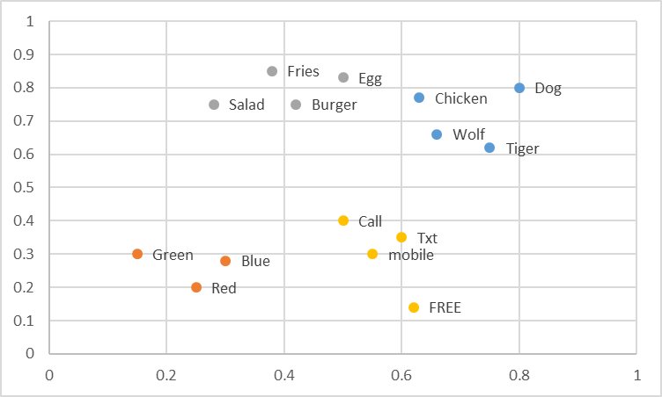
Embeddings -- Word2Vec and FastText
Word -> Coordinate in N dimension
Regions of space contain similar concepts
Creating Features Options:
Average vector across words
Count in specific regions
Commonly used with neural networks
Replaces words with their ‘meanings’ – sparse -> dense representation

Slide 26
Normalization (Numeric => Better Numeric)
Helps make model’s job easier
No need to learn what is ‘big’ or ‘small’ for the feature
Some model types benefit more than others
To use in practice:
Estimate mean/stdev on training data
Apply normalization using those parameters to validation /train
Raw X
Normalize
Mean
Normalize
Variance
36
74
22
81
105
113
77
91
-38.875
-0.875
-52.875
6.125
30.125
38.125
2.125
16.125
-1.31696
-0.02964
-1.79123
0.207495
1.020536
1.29155
0.071988
0.546262
Subtract
Mean
Divide by
Stdev
Mean: 74.875
Mean: 0
Mean: 0
Std: 29.5188
Std: 1

Slide 27
Notes:
Imputation ➔ “guessing“ missing values

Slide 28
Feature Selection
Which features to use?
How many features to use?
Approaches:
Frequency
Mutual Information
Accuracy

Slide 29
Feature Selection: Frequency
Take top N most common features in the training set
Feature | Count
to | 1745
you | 1526
I | 1369
a | 1337
the | 1007
and | 758
in | 400
… | …

Slide 30
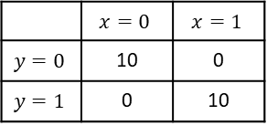
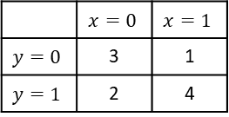

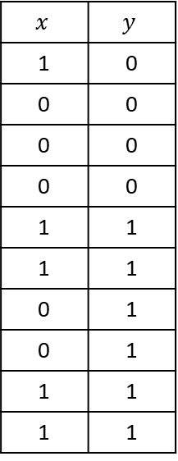
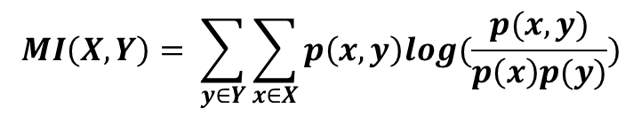


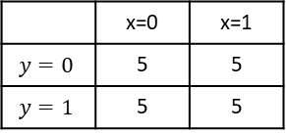
Feature Selection: Mutual Information
Take N that contain most information about target on the training set
$$MI\left(X,Y\right)= \sum_{y∈Y}{\sum_{x∈X}{p\left(x,y\right)log(\frac{p(x,y)}{p\left(x\right)p(y)})}}$$
$$x$$ | $$y$$
1 | 0
0 | 0
0 | 0
0 | 0
1 | 1
1 | 1
0 | 1
0 | 1
1 | 1
1 | 1
$$p\left(x=0,y=0\right)log\left(\frac{p\left(x=0,y=0\right)}{p\left(x=0\right)p\left(y=0\right)}\right)$$
$$= .3 ∗log\left(\frac{.3}{.5 ∗ .4}\right)=0.122$$
 | $$x=0$$ | $$x=1$$
$$y=0$$ | 3 | 1
$$y=1$$ | 2 | 4
Sum over all combinations: MI = 0.086
Contingency
Table
 | $$x=0$$ | $$x=1$$
$$y=0$$ | 10 | 0
$$y=1$$ | 0 | 10
Perfect predictor → high MI
 | x=0 | x=1
$$y=0$$ | 5 | 5
$$y=1$$ | 5 | 5
Training Data
No Information → 0 MI
Additive Smoothing to avoid 0s: $P\left(∗\right)= \frac{Obs\left(∗\right)+1}{N+2}$
Notes:
Log(1) = 0
Log(2) ~ .3

Slide 31
Feature Selection: Accuracy (wrapper)
Take N that improve accuracy most on hold out data
Greedy search, adding or removing features
From baseline, try adding (removing) each candidate
Build a model
Evaluate on hold out data
Add (remove) the best
Repeat till you get to N
Remove | Accuracy
<None> | 88.2%
claim | 82.1%
FREE | 86.5%
or | 87.8%
to | 89.8%
… | …

Slide 32
Important note about feature selection
Do not use validation (or test) data when doing feature selection
Use train data only to select features
Then apply the selected features to the validation (or test) data

Slide 33
Notes:
Imputation ➔ “guessing“ missing values

Slide 34
More Advanced Feature Selection: Importance Ranking

Slide 35
Perspectives
searching for the best subset of features.
criteria for evaluating different subsets.
principle for selecting, adding, removing or changing new features during the search.

Slide 36
Perspectives: Search of a Subset of Features
FS can be considered as a search problem, where each state of the search space corresponds to a concrete subset of features selected.
The selection can be represented as a binary array, with each element corresponding to the value 1, if the feature is currently selected by the algorithm and 0, if it does not occur.
There should be a total of 2^{M} subsets where M is the number of features of a data set.

Slide 37
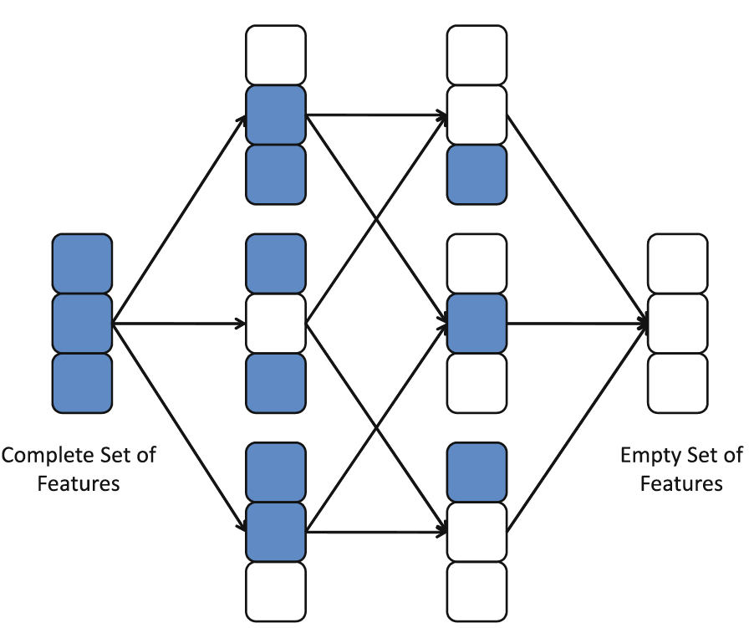
Perspectives: Search of a Subset of Features
Search
Space:

Slide 38
Perspectives: Search of a Subset of Features
Search Directions:
Sequential Forward Generation (SFG): It starts with an empty set of features S. As the search starts, features are added into S according to some criterion that distinguish the best feature from the others. S grows until it reaches a full set of original features. The stopping criteria can be a threshold for the number of relevant features m or simply the generation of all possible subsets in brute force mode.
Sequential Backward Generation (SBG): It starts with a full set of features and,iteratively, they are removed one at a time. Here, the criterion must point out the worst or least important feature. By the end, the subset is only composed of a unique feature, which is considered to be the most informative of the whole set. As in the previous case, different stopping criteria can be used.

Slide 39
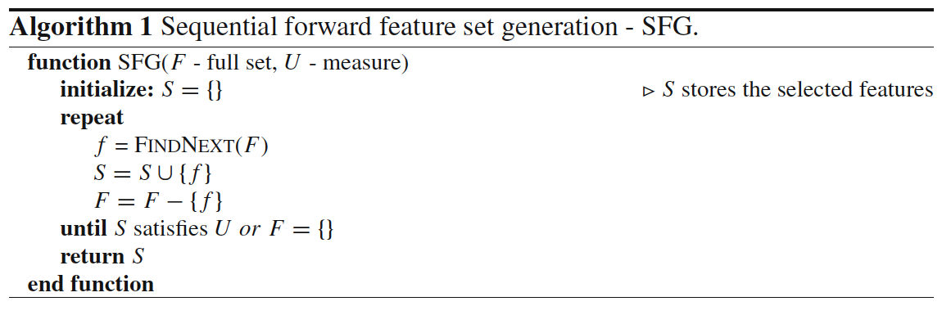
Perspectives: Search of a Subset of Features
Search Directions:

Slide 40
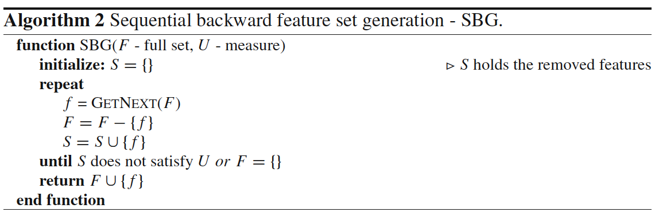
Perspectives: Search of a Subset of Features
Search Directions:

Slide 41
Perspectives: Search of a Subset of Features
Search Directions:
Bidirectional Generation (BG): Begins the search in both directions, performing SFG and SBG concurrently. They stop in two cases: (1) when one search finds the best subset comprised of m features before it reaches the exact middle, or (2) both searches achieve the middle of the search space. It takes advantage of both SFG and SBG.
Random Generation (RG): It starts the search in a random direction. The choice of adding or removing a features is a random decision. RGtries to avoid the stagnation into a local optima by not following a fixed way for subset generation. Unlike SFG or SBG, the size of the subset of features cannot be stipulated.

Slide 42
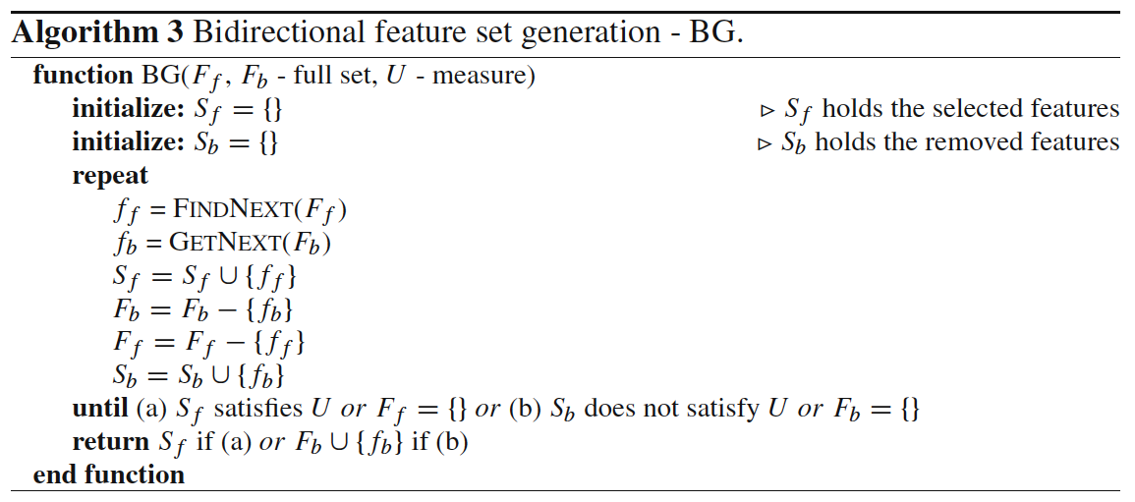
Perspectives: Search of a Subset of Features
Search Directions:

Slide 43
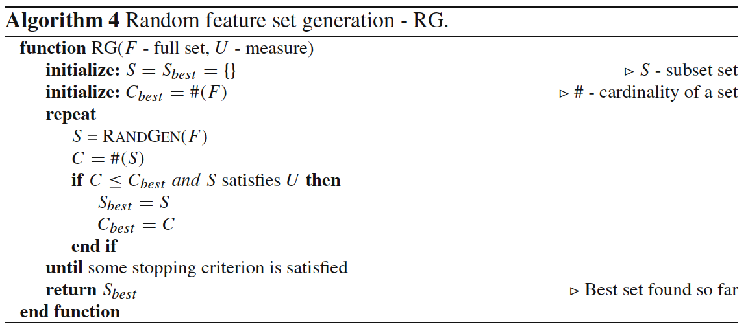
Perspectives: Search of a Subset of Features
Search Directions:

Slide 44
Perspectives: Search of a Subset of Features
Search Strategies:
Exhaustive Search: It corresponds to explore all possible subsets to find the optimal ones. As we said before, the space complexity is O(2^{M}). If we establish a threshold m of minimum features to be selected and the direction of search, the search space is, independent of the forward or backward generation. Only exhaustive search can guarantee the optimality. Nevertheless, they are also impractical in real data sets with a high M.
Heuristic Search: It employs heuristics to carry out the search. Thus, it prevents brute force search, but it will surely find a non-optimal subset of features. It draws a path connecting the beginning and the end of the previous Figure, such in a way of a depth-first search. The maximum length of this path is M and the number of subsets generated is O(M). The choice of the heuristic is crucial to find a closer optimal subset of features in a faster operation.

Slide 45
Perspectives: Search of a Subset of Features
Search Strategies:
Nondeterministic Search: Complementary combination of the previous two. It is also known as random search strategy and can generate best subsets constantly and keep improving the quality of selected features as time goes by. In each step, the next subset is obtained at random.
it is unnecessary to wait until the search ends.
we do not know when the optimal set is obtained, although we know which one is better than the previous one and which one is the best at the moment.

Slide 46

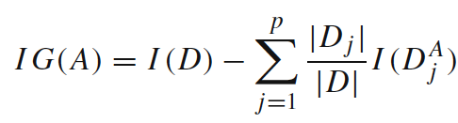
Perspectives: Selection Criteria
Information Measures.
Information serves to measure the uncertainty of the receiver when she/he receives a message.
Shannon’s Entropy:
Information gain:

Slide 47
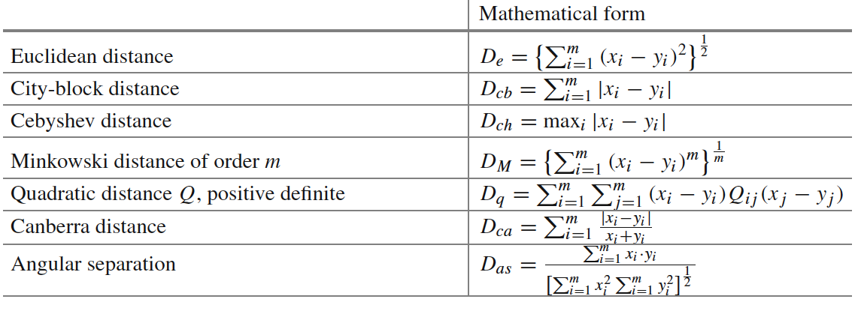
Perspectives: Selection Criteria
Distance Measures.
Measures of separability, discrimination or divergence. The most typical is derived from distance between the class conditional density functions.

Slide 48
Perspectives: Selection Criteria
Distance Measures.
Measures of separability, discrimination or divergence. The most typical is derived from distance between the class conditional density functions.

Slide 49
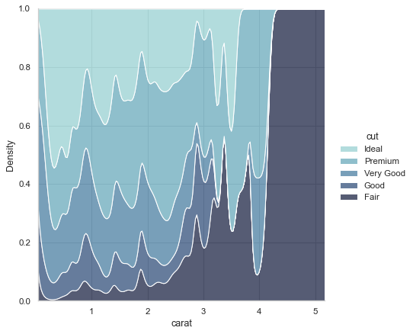

Slide 50
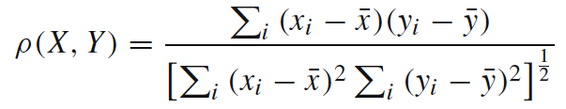
Perspectives: Selection Criteria
Dependence Measures.
known as measures of association or correlation.
Quantify how strongly two variables are correlated
present some association with each other
knowing the value of one of them, we derive the value for the other… For example:
Pearson correlation coefficient:

Slide 51
Perspectives: Selection Criteria
Consistency Measures.
They attempt to find a minimum number of features that separate classes as the full set of features can.
They aim to achieve P(C|FullSet) = P(C|SubSet).
An inconsistency is defined as the case of two examples with the same inputs (same feature values) but with different output feature values (classes in classification).

Slide 52
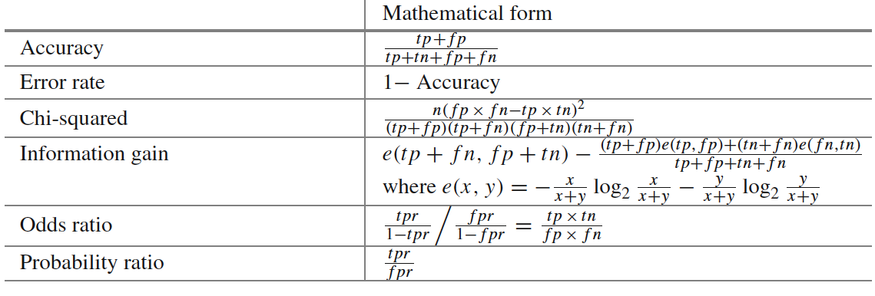
Perspectives: Selection Criteria
Accuracy Measures.
This form of evaluation relies on the classifier or learner. Among various possible subsets of features, the subset which yields the best predictive accuracy is chosen

Slide 53
Perspectives
Filters:
measuring uncertainty, distances, dependence or consistency is usually cheaper than measuring the accuracy of a learning process. Thus, filter methods are usually faster.
it does not rely on a particular learning bias, in such a way that the selected features can be used to learn different models from different DM techniques.
it can handle larger sized data, due to the simplicity and low time complexity of the evaluation measures.

Slide 54
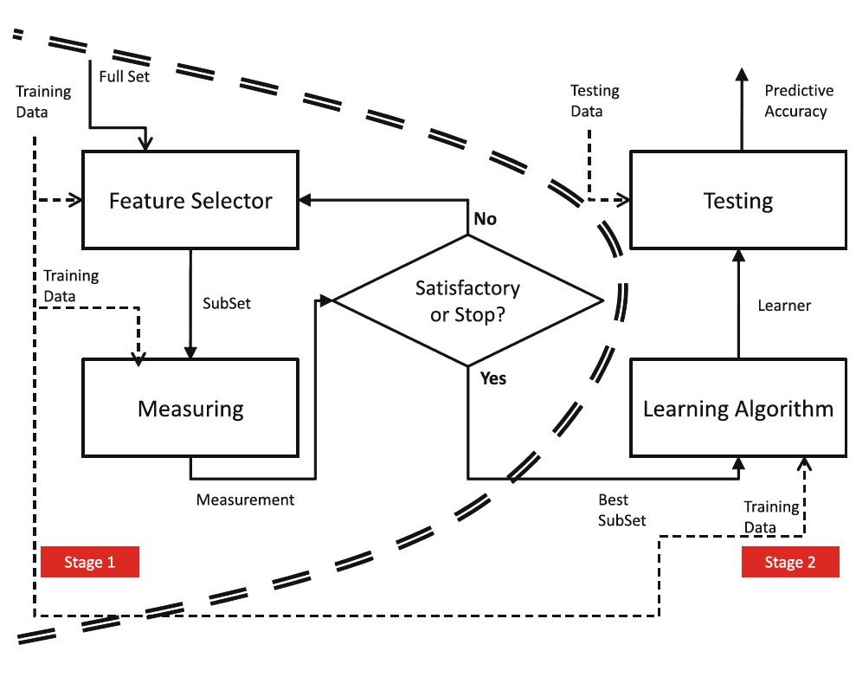
Perspectives
Filters:

Slide 55
Perspectives
Wrappers:
can achieve the purpose of improving the particular learner’s predictive performance.
usage of internal statistical validation to control the overfitting, ensembles of learners and hybridizations with heuristic learning like Bayesian classifiers or Decision Tree induction.
filter models cannot allow a learning algorithm to fully exploit its bias, whereas wrapper methods do.

Slide 56
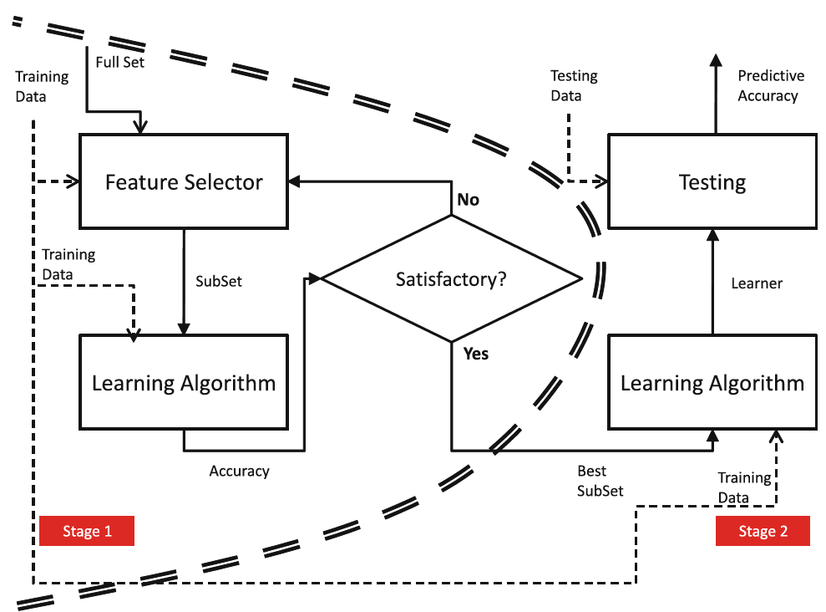
Perspectives
Wrappers:

Slide 57
Perspectives
Embedded FS:
similar to the wrapper approach in the sense that the features are specifically selected for a certain learning algorithm, but in this approach, the features are selected during the learning process.
they could take advantage of the available data by not requiring to split the training data into a training and validation set; they could achieve a faster solution by avoiding the re-training of a predictor for each feature subset explored.

Slide 58
Aspects: Output of Feature Selection
Feature Ranking Techniques:
we expect as the output a ranked list of features which are ordered according to evaluation measures.
they return the relevance of the features.
For performing actual FS, the simplest way is to choose the first m features for the task at hand, whenever we know the most appropriate m value.

Slide 59
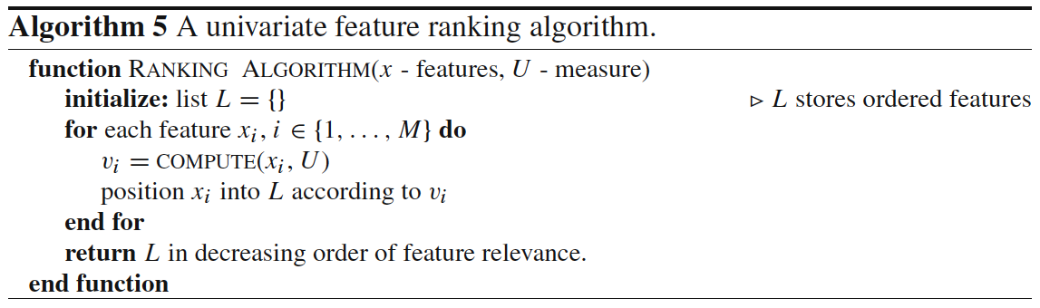
Aspects: Output of Feature Selection
Feature Ranking Techniques:

Slide 60
Aspects: Output of Feature Selection
Minimum Subset Techniques:
The number of relevant features is a parameter that is often not known by the practitioner.
There must be a second category of techniques focused on obtaining the minimum possible subset without ordering the features.
whatever is relevant within the subset, is otherwise irrelevant.

Slide 61
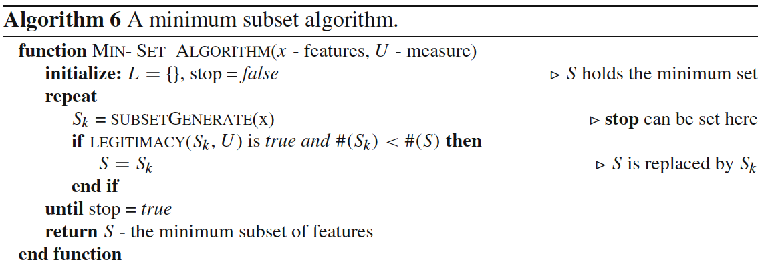
Aspects: Output of Feature Selection
Minimum Subset Techniques:

Slide 62
Aspects: Evaluation
Goals:
Inferability: For predictive tasks, considered as an improvement of the prediction of unseen examples with respect to the direct usage of the raw training data.
Interpretability: Given the incomprehension of raw data by humans, DM is also used for generating more understandable structure representation that can explain the behavior of the data.
Data Reduction: It is better and simpler to handle data with lower dimensions in terms of efficiency and interpretability.

Slide 63
Aspects: Evaluation
We can derive three assessment measures from these three goals:
Accuracy
Complexity
Number of Features Selected
Speed of the FS method
Generality of the features selected

Slide 64
Aspects: Drawbacks
The resulted subsets of many models of FS are strongly dependent on the training set size.
It is not true that a large dimensionality input can always be reduced to a small subset of features because the objective feature is actually related with many input features and the removal of any of them will seriously effect the learning performance.
A backward removal strategy is very slow when working with large-scale data sets. This is because in the firsts stages of the algorithm, it has to make decisions funded on huge quantities of data.
In some cases, the FS outcome will still be left with a relatively large number of relevant features which even inhibit the use of complex learning methods.

Slide 65
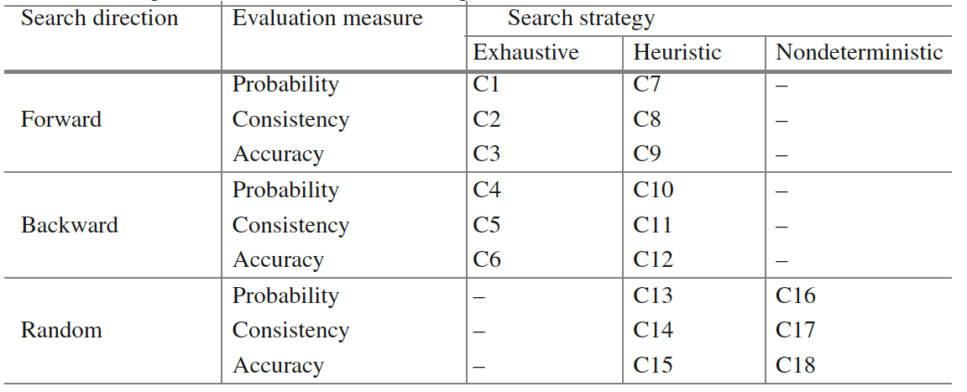
Most Representative Methods
Three major components to categorize combinations:
Search Direction
Search Strategy
Evaluation Measure

Slide 66
Most Representative Methods Exhaustive Methods
Cover the whole search space.
Six Combinations (C1-C6).
Focus method: C2.
Automatic Branch and Bound (ABB): C5.
Best First Search (BFS): C1.
Beam Search: C3.
Branch and Bound (BB): C4.

Slide 67
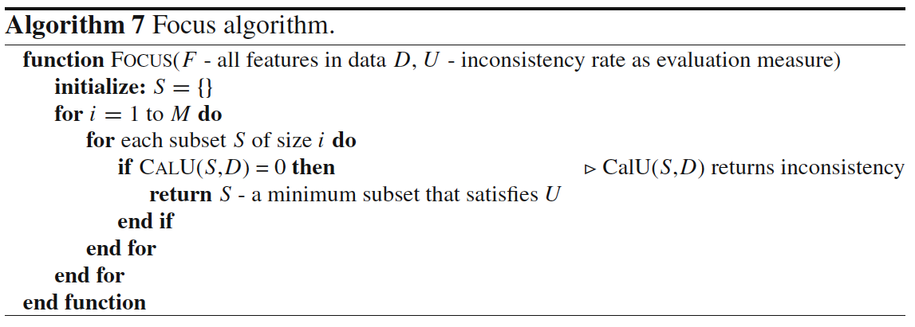
Most Representative Methods Exhaustive Methods

Slide 68
Most Representative Methods Heuristic Methods
They do not have any expectations of finding an optimal subset with a rapid solution.
Nine Combinations (C7-C15).
Use a DM algorithm for FS: C12.
Wrapper Sequential Forward Selection: C9.
SetCover: C8.
Heuristic search algorithm and in each sub-search space: C13-C15.
MIFS: C10.

Slide 69
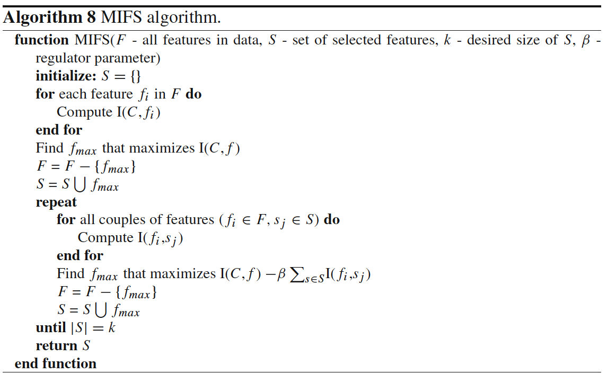
Most Representative Methods Heuristic Methods

Slide 70
Most Representative Methods Nondeterministic Methods
They add or remove features to and from a subset without a sequential order.
Three Combinations (C16-C18).
Simulated Annealing / Genetic Algorithms are the most common techniques.
LVF: C17.
LVW: C18.

Slide 71
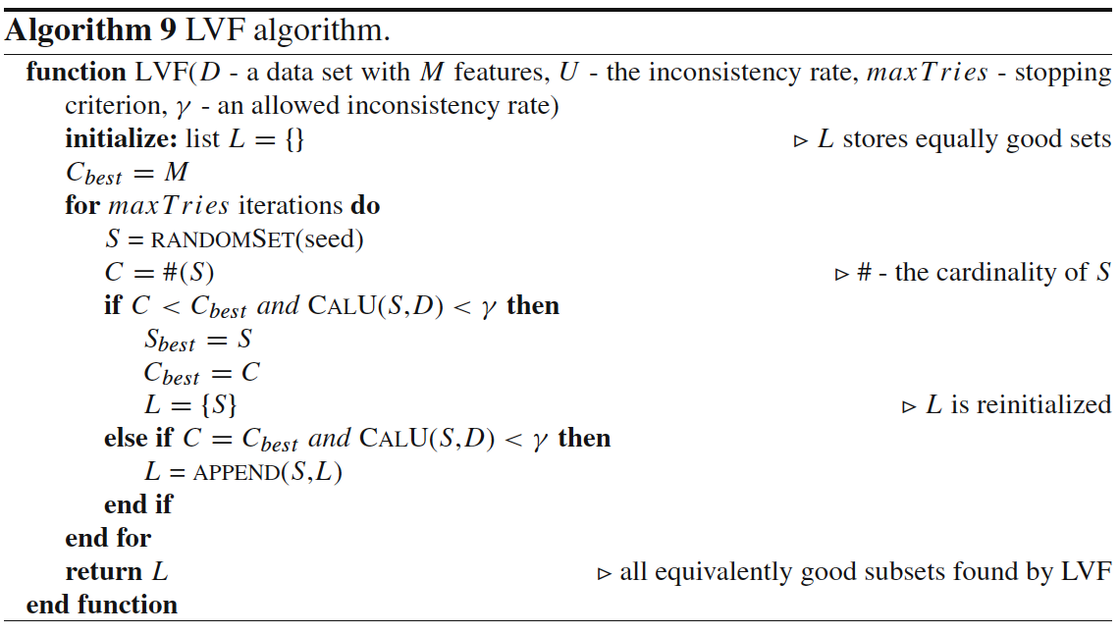
Most Representative Methods Nondeterministic Methods

Slide 72
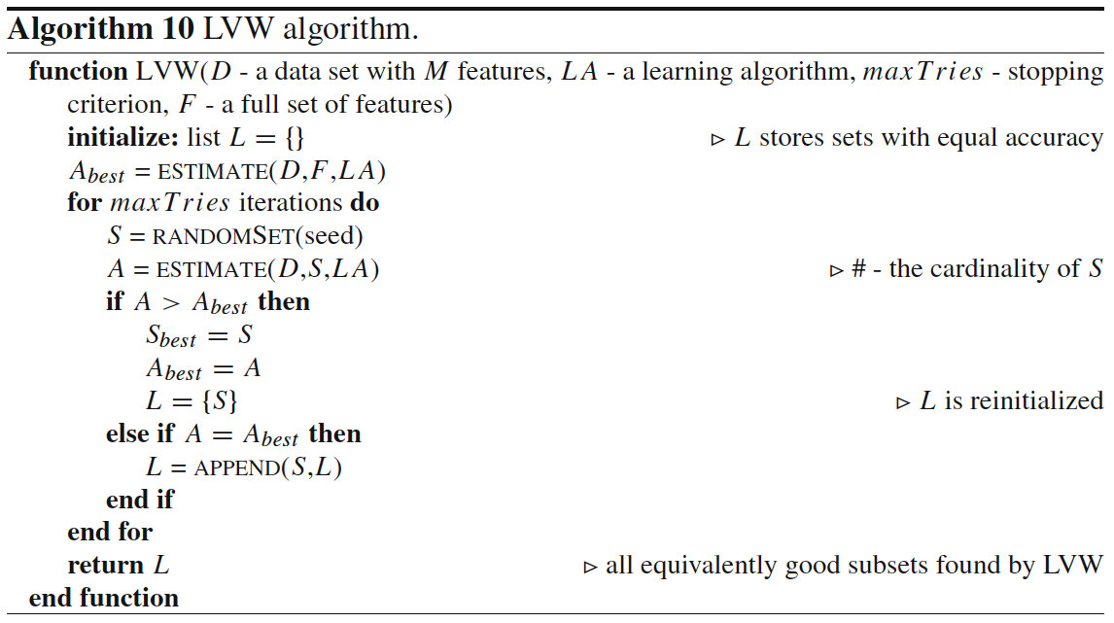
Most Representative Methods Nondeterministic Methods

Slide 73
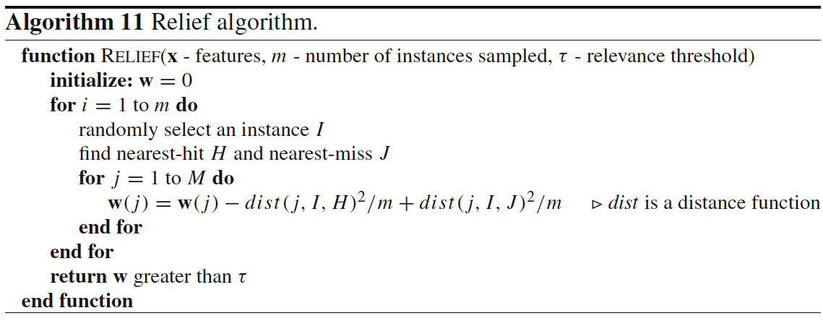
Most Representative Methods Feature Weighting Methods
Provide weights to features, also can be used for FS.
Relief (binary) and ReliefF (multipe classes).

Slide 74
Simple Feature Engineering Pattern
Input for machine learning model at runtime
TrainingContextX
runtimeContextX
FeaturizeTraining
Featurize Runtime
runtimeX
TrainingY
Featurize Data
Selected words / n-grams and their feature indexes
TF-IDF weights to use for each word
Raw data to featurize and do feature selection with
Info needed to turn raw context into features
Normalize parameters for numeric features: means and stdevs

Slide 75
Simple Feature Engineering Pattern: Pseudocode
for f in featureSelectionMethodsToTry:
(trainX, trainY, featureData) = FeaturizeTraining(rawTrainX, rawTrainY, f)
(validationX, validationY) = FeaturizeRuntime(rawValidationX, rawValidationY, f, featureData)
for hp in hyperParametersToTry:
model.fit(trainX, trainY, hp)
accuracies[hp, f] = evaluate(validationY, model.predict(validationX))
(bestHyperParametersFound, bestFeaturizerFound) = bestSettingFound(accuracies)
(finalTrainX, finalTrainY, featureData) =
FeaturizeTraining(rawTrainX + rawValidationX, rawTrainY + rawValidationY, bestFeaturizerFound)
(testX, testY) = FeaturizeRuntime(rawTextX, rawTestY, bestFeaturizerFound, featureData)
finalModel.fit(finalTrainX, finalTrainY, bestHyperParametersFound)
estimateOfGeneralizationPerformance = evaluate(testY, model.predict(testX))

Slide 76
Understanding Mistakes
Noise in the data
Encodings
Bugs
Missing values
Corruption
Noise in the labels
Ham: As per your request 'Melle Melle (Oru Minnaminunginte Nurungu Vettam)' has been set as your callertune for all Callers. Press *9 to copy your friends Callertune
Spam: I’ll meet you at the resturant between 10 & 10:30 – can’t wait!
Model being wrong…
Reason?

Slide 77
Exploring Mistakes
Examine N random false positive and N random false negatives
Examine N worst false positives and N worst false negatives
Model predicts very near 1, but true answer is 0
Model predicts very near 0, but true answer is 1
Reason | Count
Label Noise | 2
Slang | 5
Non-English | 5
… | …

Slide 78
Approach to Feature Engineering
Start with ‘standard’ for your domain; 1 parameter per ~10 samples
Try all the important variations on hold out data
Tokenizing
Bag of words
N-grams
…
Use some form of feature selection to find the best, evaluate
Look at your mistakes…
Use your intuition about your domain and adapt standard approaches or invent new features…
Iterate
When you want to know how well you did, evaluate on test data

Slide 79
Feature Engineering in Other Domains
Computer Vision:
Gradients
Histograms
Convolutions
Time Series:
Window aggregated statistics
Frequency domain transformations
Internet:
IP Parts
Domains
Relationships
Reputation
Neural Networks:
A whole bunch of other things we’ll talk about later…

Slide 80
Summary of Feature Engineering
Feature engineering converts raw context into inputs for machine learning
Goals are:
Match structure of concept to structure of model representation
Balance number of feature, amount of data, complexity of concept, power of model
Every domain has a library of proven feature engineering approaches
Text’s include: normalization, tokenizing, n-grams, TF-IDF, embeddings, & NLP
Feature selection removes less useful features and can greatly increase accuracy

